Slide 1
Parameterized SQL
Using T-SQL (MS SQL Server)
sp_executeSQL
SQL injection

Slide 2
SQL, T-SQL, PL/SQL
SQL: Structured Query Language - ANSI 1986, ISO 1987
T-SQL: MS SQL Server branded SQL
PL/SQL: Oracle branded SQL

Slide 3
Static SQL versus Dynamic SQL Definitions
Static SQL – A simple select statement, often stored as a procedure. The query never changes; it always asked the same thing and returns whatever values may have changed between asks.
Dynamic SQL – A select statement with @parameters. The query is dynamic because the value being searched is open ended and may be modified by the user at the time of execution.

Slide 4
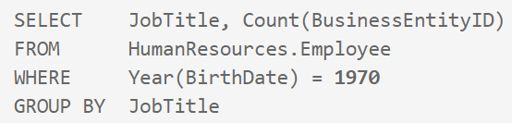

Dynamic SQL versus Static SQL

Slide 5
Dynamic SQL Walkthrough:
SPROC with Parameters
Exec (@sql) variable statements
sp_executeSQL system level proc
CREATE PROC uspGetCustomers @city nvarchar(20)
AS
BEGIN
SELECT * FROM Person.Address WHERE City = @city
END
--execute SPROC
exec uspGetCustomers @city = 'London'
https://www.mssqltips.com/sqlservertip/1160/execute-dynamic-sql-commands-in-sql-server/
DECLARE @sqlCommand varchar(1000)
DECLARE @columnList varchar(75)
DECLARE @city varchar(20)
SET @columnList = 'AddressID, AddressLine1, City'
SET @city = '''London'''
SET @sqlCommand = 'SELECT ' + @columnList + ' FROM Person.Address WHERE City = ' + @city
EXEC (@sqlCommand)
DECLARE @sqlCommand nvarchar(1000)
DECLARE @columnList varchar(75)
DECLARE @city varchar(75)
SET @columnList = 'AddressID, AddressLine1, City'
SET @city = 'London'
SET @sqlCommand = 'SELECT ' + @columnList + ' FROM Person.Address WHERE City = @city'
EXECUTE sp_executesql @sqlCommand, N'@city nvarchar(75)', @city = @city

Slide 6
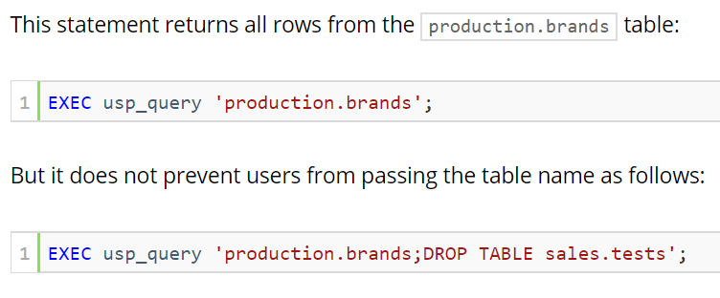
Execute/Exec vs sp_executeSQL
Exec, Execute – Command to execute a SPROC.
System will execute any correct statement contained in the SPROC. This leads to the classic example of the SQL Injection.
Exec(@sql) – SQL statements set in a variable, executed by exec command
sp_executeSQL – system “stored procedure” that executes a query that has been stored in a variable (dynamic query).
sp_executeSQL @SQL
By executing dynamic and parameterized statement; potential for injection is reduced.

Slide 7
What is “parameterized” SQL ?
User/dev writes an entire query and ‘stores it’ in a variable or proc.
Exec or sp_executeSQL calls and executes the contents of the variable as it is ‘passed.’
This differs from a SPROC or UDF in that the query is “built on the fly” because it is being called from the variable (@SQL) or from the sys proc, instead of being run as a compiled procedure (SPROC, UDF).

Slide 8
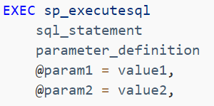
Syntax for parameterized SQL
EXEC sp_executesql @SQL;
EXECUTE @SQL;
sql_statement contains the query
SET @SQL = N 'Select * From'
Parameter_definition contains the variables
@col1, @col2
@param sets the variable’s value
@col1 = ‘value’

Slide 9
Tutorial walkthroughs Dynamic SQL, sp_executeSQL
https://www.essentialsql.com/build-dynamic-sql-stored-procedure/
http://www.sqlservertutorial.net/sql-server-stored-procedures/sql-server-dynamic-sql/

Slide 10
SQL Injection
SQL injection is a code injection technique, used to attack data-driven applications, in which malicious SQL statements are inserted into an entry field for execution. (Wiki)
SQL injection is an attack in which malicious code is inserted into strings that are later passed to an instance of SQL Server for parsing and execution. (docs.Microsoft)

Slide 11
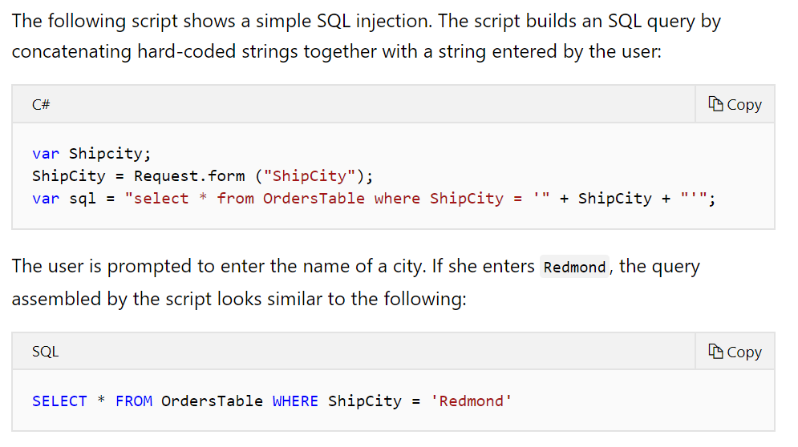
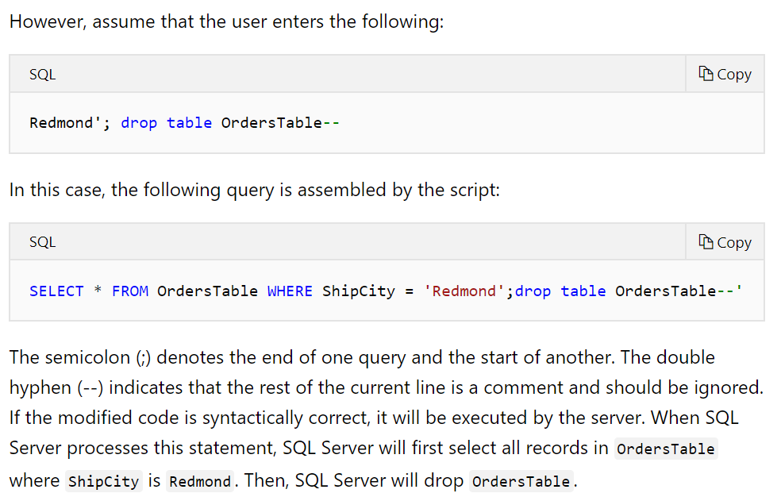
SQL Injection Explained with Walkthrough
https://docs.microsoft.com/en-us/sql/relational-databases/security/sql-injection?view=sql-server-2017

Slide 12
Practice Example for Parameterized Statement
DECLARE @IntVariable int;
DECLARE @SQLString nvarchar(500);
DECLARE @ParmDefinition nvarchar(500);
SET @SQLString =
N'SELECT BusinessEntityID, NationalIDNumber, JobTitle, LoginID
FROM AdventureWorks2012.HumanResources.Employee
WHERE BusinessEntityID = @BusinessEntityID';
SET @ParmDefinition = N'@BusinessEntityID tinyint';
--use parameter to run query
SET @IntVariable = 197;
EXECUTE sp_executesql @SQLString, @ParmDefinition, @BusinessEntityID = @IntVariable;
--reuse parameter with new value to run same query
SET @IntVariable = 109;
EXECUTE sp_executesql @SQLString, @ParmDefinition, @BusinessEntityID = @IntVariable;

Slide 13
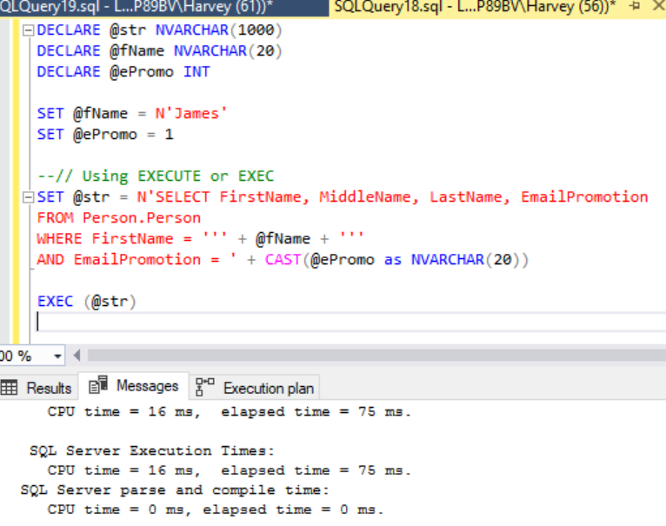
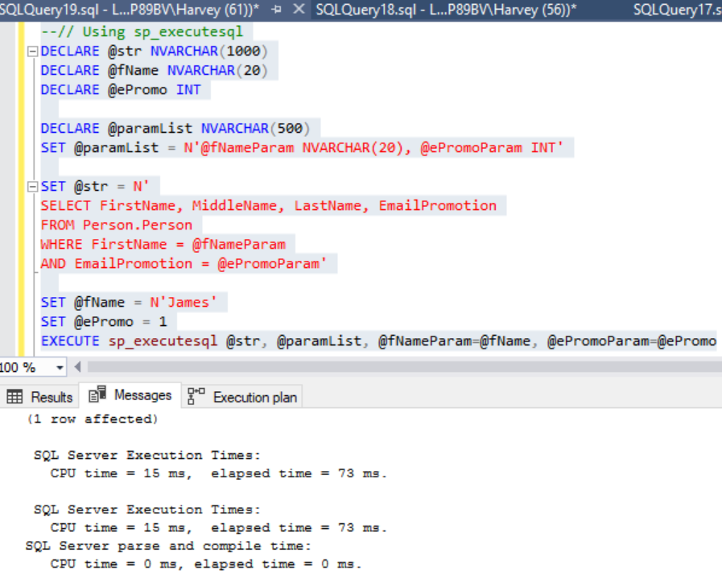
Exec (@SQL) versus sp_executeSQL @SQL

Slide 14
Why Exec SQL versus Exec Proc?
Sp_executeSQL:
Performance – Uses cache plan
Security – Prevent SQL injection
Temp Tables – Passing result instead of Temp table

Slide 15
Exercise for @SQL
Create a select statement
Must contain 1 join, 2 aggregators
Must have if/else
Create select with a parameter SPROC
Create select, Execute with EXEC (@SQL)
Create select as, Execute with sp_executeSQL @SQL
Create exec @SQL called within SPROC
Run examples to show differences in performance
Must use as least 3 parameters
Must support a user story

Slide 16
Exercise for SQL Injection
Create a SPROC that allows a SQL Injection attack.
Recreate the SPROC to prevent the attack using any of the methods discussed.
Must support a user story.

Slide 17
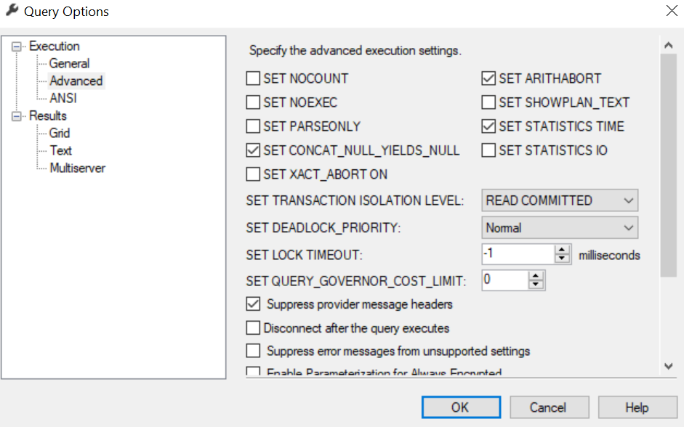
Additional Considerations
NOEXEC option
Quotename() function

